Slide 1
Threat prevention and Detection
Jake Ellis & Michael Colliver

Slide 2
Introduction
According to Webster’s dictionary the definition of a threat is “An expression of intention to inflict evil, injury, or damage”.
As the complexity of databases grow, so do the aspects related to threats
Threats can be both internal and external to an organization

Slide 3
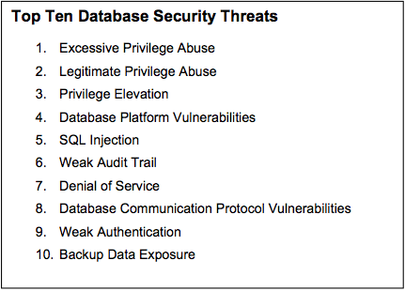
Top database Threats
These are the top ten threats according to Imperva’s Application Defense Center. Imperva is one of the leaders in data security which offers several of its solutions to top US commercial banks and global oil & gas companies.

Slide 4
Legitimate Privilege Abuse This is a threat posed from the user acting within the privileges he/she was given. This is often a threat that is unintentional where the user means no harm but can still produce harm because it causes the system to act in a way that was unintended. Prevention: Monitoring users that may be using legitimate privileges in a harmful manor
Excessive Privilege Abuse
This threat is defined directly by its title. It occurs, “when users (or applicants) are granted database access privileges that exceed the requirements of their job functions, these privileges may be abused for malicious purposes”.
Prevention: In order to counter this threat, oppose it by setting the bar low. Give users minimum rights as possible.
Privilege Elevation
In simplest terms this is converting from a user to a superuser. “Attackers may take advantage of database platform software vulnerabilities to convert access privileges from those of an ordinary user to those of an administrator.
Prevention: intrusion prevention systems (IPS) and query-level access controls

Slide 5
SQL Injection This is probably the most commonly noted database threat. In this situation an attacker inserts characters forming a statement into the vulnerability. Depending on the injected statement and the vulnerability the whole database could potentially be uncovered. Prevention: Intrusion Prevention Systems, query-level access control, and event correlation. One of these alone will not protect from SQL injection.
Platform Vulnerabilities
This stems from weaknesses in the base operating system. One famous example is the Blaster Worm. It created a denial of service, but did so by taking advantage of vulnerabilities in the Windows 2000 operating system.
Prevention: implement suggested patches
Weak Audit Trail
Comparatively to those threats mentioned previously, this threat may seem curious but it is still a threat nevertheless. The threat of a weak audit trail implies that of a poor recording or tracking system.
Prevention: To thwart this threat you may have to import other applications into your system until an appropriate level of transaction recording to meet your needs can be established

Slide 6
Weak Authentication This is exactly as the title implies. An unauthorized user is granted access into the database because of the fact that the standards for authentication to access the database were inadequate. Prevention: When possible, use two-factor authentication. Good password policy will advise you to implement a minimum length, character diversity, and etc.
Denial of Service
“Denial of Service (DoS) is a general attack category in which access to network applications or data is denied to intended users
Prevention: Network, application, and database level protections are all necessary
Database Communication Protocol Vulnerabilities
This is a threat that is getting a lot of recognition. “Four out of seven fixes in the two most recent IBM DB2 FixPacks address protocol vulnerabilities.” What this threat refers to is the conventions for the conveyance of data. (Shulman)
Prevention: protocol validation takes apart the traffic of the database and then it tries to match it to what it believes is expected within the system

Slide 7
Backup Data Exposure
In many cases backups can become the afterthoughts of a project. Because of this they may become completely unprotected- either digitally or physically. Digitally in that they can be directly accessed without any authentication such as login or physically such as they can easily be stolen without immediate notice of their absence.
Prevention: encrypt backup data.

Slide 8
Conclusion
Once a threat has been determined it is appropriate to identify where exactly the particular threat is coming from. Breaking down the point of origin to simplest form the threat can either be internal or external. Assuming an organizational setting this means that the attacker is either a member of the company, an employee, or simply an average person outside the bounds of the company.
Prevention measures need to be set in place well before hand and there is an inherent need for detection devices to become more and more automated

Slide 9
References
Imperva. Company Overview. 2012. Imperva. Retrieved from http://www.imperva.com/company/company.html
Intuit. A Timeline of Database History. Intuit QuickBase. 2012. Retrieved from http://quickbase.intuit.com/articles/timeline-of-database-history
Shulman, Amichai. Top Ten Database Security Threats. Imperva. 2006. Retrieved from http://www.schell.com/Top_Ten_Database_Threats.pdf
"Threat". Merriam-Webster.com. 2012. Retrieved from http://www.merriam-webster.com

